Slide 1
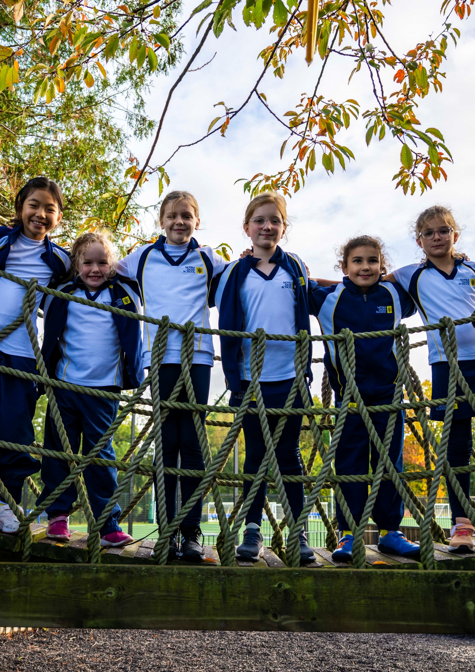
Marketing &
Admissions
Assistant
Candidate Information Pack
Permanent
Part-time – 30 Hours a week
Term Time Plus 3 Weeks
Required ASAP

Slide 2
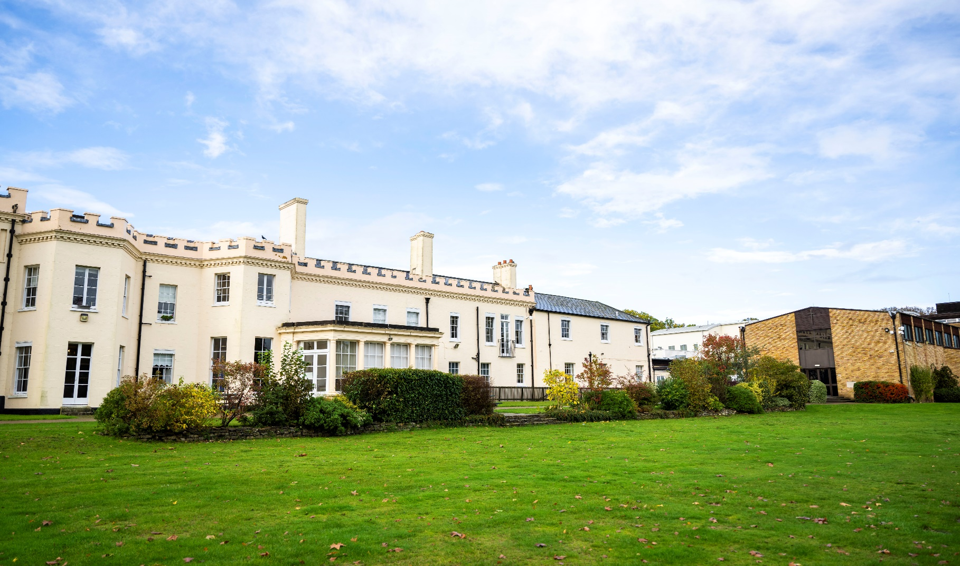
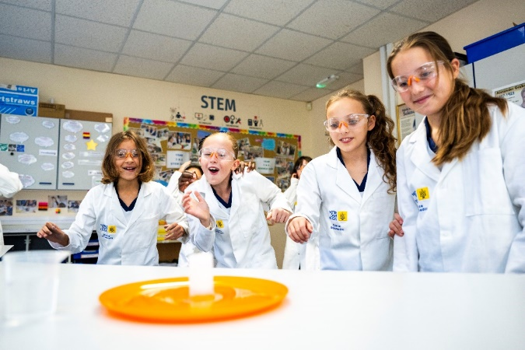
Our School
    Notre Dame is an independent Catholic Day School set in 26 acres of beautiful, rural Surrey parkland. We warmly welcome families of all faiths and none.
    At Notre Dame School, we are unashamedly holistic, and our 700 students from aged 2-18 are at the centre of everything we do. We focus on Happiness and Success – in that order. We are profoundly committed to this educational philosophy and through it we fulfil our aim of providing an exemplary all-round education. The academic, creative, physical, moral and intellectual challenges expected in all good schools, complete with state-of-the-art facilities, are balanced with fun and laughter and a trusting and compassionate atmosphere which enables everyone in our community to be the best possible versions of themselves.
    For more than 400 years, pastoral care has been embedded at the heart of our approach to education. This is not at the expense of academic rigour. Rather, it forms the bedrock on which academic excellence is built: happy, comfortable and secure children and young women make confident and successful learners. All our students, from the smallest to our Sixth Formers, have access to our wonderful grounds and on-site facilities – all-weather sports pitches, indoor swimming pool, professional theatre, gymnasium, sports hall, music rooms, dedicated science laboratories, libraries and woodland forest school.
    Notre Dame School is proud to have been shortlisted for the Best Independent Girls’ School of the Year Award 2025.
“Accompanying young people in their efforts to build their lives for today and tomorrow.”

Slide 3
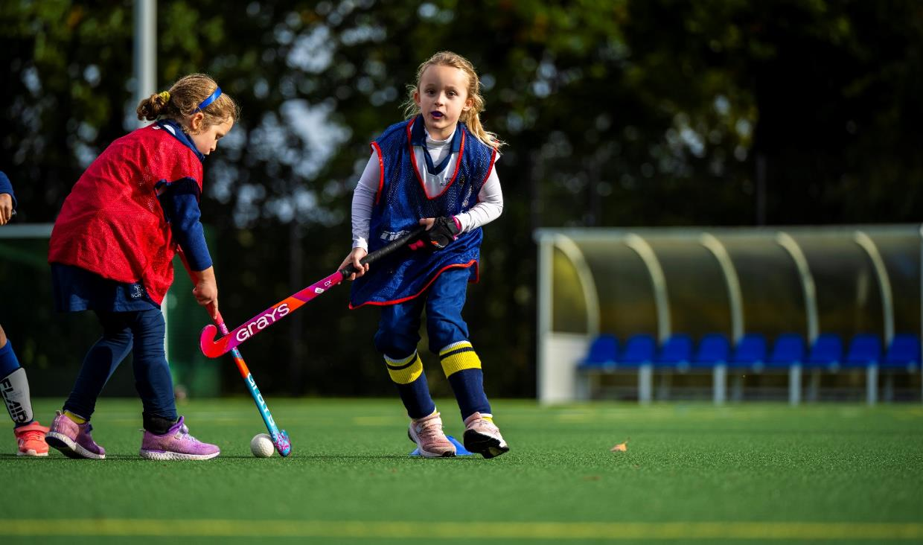

Heritage & Ethos
    The Company of Mary Our Lady was founded in Bordeaux in 1607 by St Jeanne de Lestonnac to educate girls of all faiths and is the oldest recognised educational order in the world. Today there are more than 300 CoMOL schools, educational foundations and projects across 26 countries.
    Notre Dame School is the only one in the UK.
    Our foundress, St Jeanne de Lestonnac, a mother of 5 children, was a progressive and dedicated educator. She grew up in an intellectual and cultured family and was exposed to many different religious and philosophical perspectives. Her forward-thinking approach to education is as fresh and modern today, and we strive to live up to her indomitable spirit and drive and remain committed to her mission statement:
“No one is educated in isolation; it is the whole community that educates.”
St Jeanne de Lestonnac – Foundress

Slide 4

Pupils display genuine kindness and respect for one another.
Independent School Inspections – ISI

Slide 5
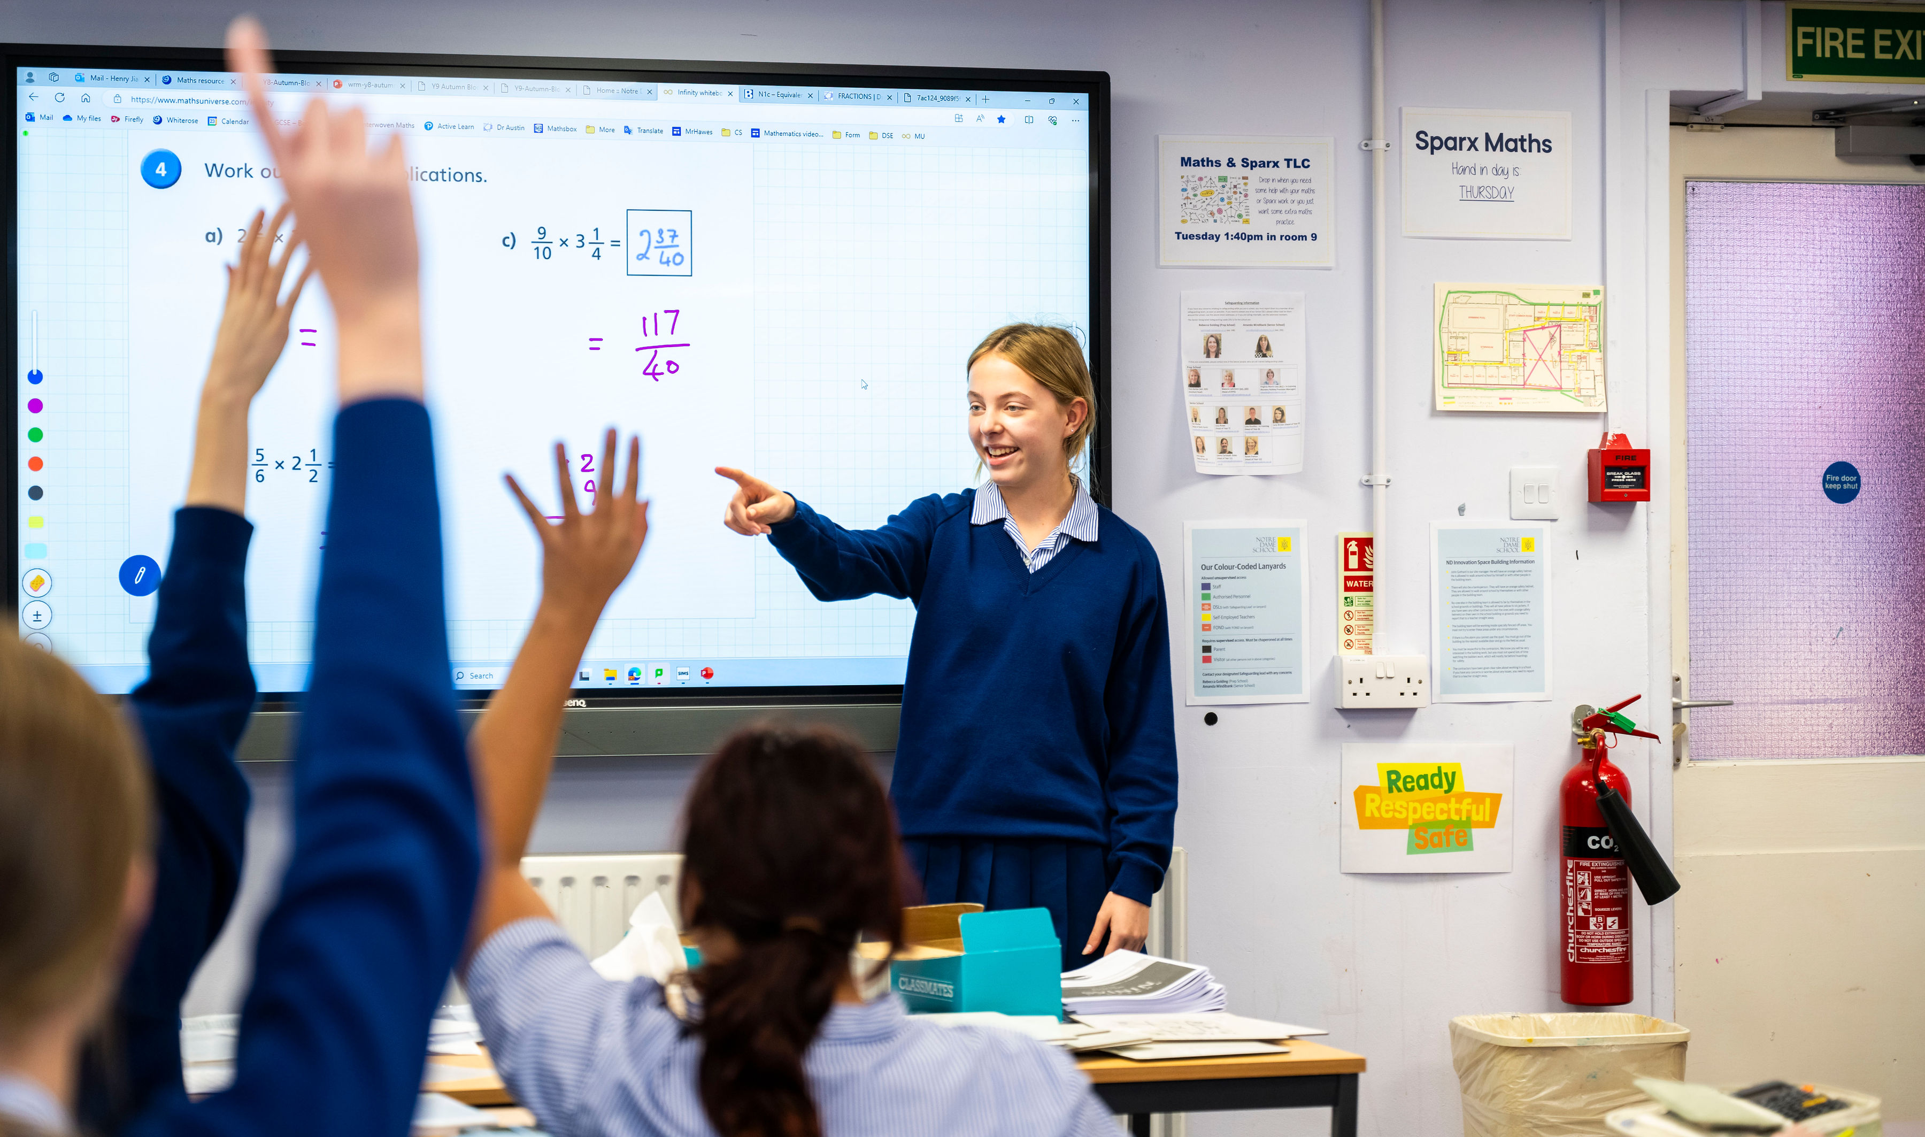
The Role
  Position Title
Marketing & Admissions Assistant
  Position Title
Head Of Marketing & Admissions
  The function of the post
    Our Assistant role is a hands-on, busy role at the heart of our Marketing and Admissions function. Reporting to the Head of Marketing & Admissions, they work closely with colleagues across the School to support the department’s administration, facilitate our marketing, and support parents and prospective students through our admissions process.
    They will be relied upon to bring excellent transferable skills and to play an active, collaborative role within the team. In line with events across the School and the marketing priorities within the admissions cycle, they will be required to proactively support all areas of the department from communication to social media.
    This role will suit someone who is immersed in a customer service-led environment, understands the importance of a school's admissions process, can champion the school’s ethos and can balance priorities in a fast-paced office.

Slide 6
Main Duties
& Responsibilities
.
Data and Analytics
Assist in tracking and reporting on the effectiveness of marketing campaigns, including Google Analytics and CRM reporting.
Assist with compiling and organising data related to admissions statistics and trends for the Head of Department, SLT and Executive teams.
Administration.
  Support Registrar in the end-to-end processing of admissions throughout the school, which may include:
  Processing admissions applications and documentation.
  Maintaining databases of prospective students.
  Assisting team members and wider staff with all communications, including the creation of artwork.
  Working with the Registrar to coordinate scholarship applications and supporting evidence
  Provide administrative support to both the Marketing and Admissions Team.
  Assist with organising events, fairs, and key admissions events, including open days, discovery workshops and taster sessions. Support the Registrar in the end-to-end processing of admissions throughout the school, which may include:
  Processing admissions applications and documentation.
  Maintaining databases of prospective students.
  Assisting team members and wider staff with all communications,
Key Objectives
Maintain and elevate brand awareness and positive reputation of Notre Dame School
Boost admissions enquiries from prospective families
Retain and engage our current parent community through communications and events
Showcase the School’s culture, values, and community to attract future families
  Marketing
Assist the Head of Marketing Admissions in the development and execution of both online and offline marketing campaigns.
Assist the Communications & Events Manager with event planning and administration including attendee information, labels and data capture sheets.
Support Content Creator with the creation of social media posts, including shooting images and video for public consumption.
Proofread marketing materials for the wider team, such as brochures, communication and emails.
Conduct market research to identify trends and competitor analysis for the Head of Marketing and Admissions.
Collaborate with the Marketing Team to brainstorm and generate creative content ideas.

Slide 7
The Person
  Based onsite four days a week, with occasional event commitments, the successful candidate will support the team in delivering an impactful customer, parent, and student experience that enhances the school’s brand, reputation, and vision.
  Working across multiple platforms and tasks, you will ensure that our front-line administrative provision is consistent, high-quality, and accurate, while maintaining an exceptional customer experience.
  A desirable candidate will have:
Professional experience in a similar Marketing, Admissions or Admin Role.
Good Office skills, in particular Excel, Data sorting and Mail Merge
A solid understanding of marketing channels, campaigns, and content creation.
Confidence in managing and using social media platforms.
Experience in CRM systems would be advantageous.
A creative eye with experience of programs such as Canva, Adobe Suite, PowerPoint or similar would be advantageous.
Admin & customer service experience
Health and Safety
All employees have a legal duty to ensure the safety of themselves and all the pupils and staff within the school as detailed in the Health and Safety at Work Act 1974.
Data Protection
All employees should familiarise themselves with and follow the Data Protection guidelines and practices.
Safeguarding
The school is committed to safeguarding and promoting the welfare of children and young people and expects all staff and volunteers to share this commitment.
The duties and responsibilities contained within this job description may change from time to time according to the requirements of the role and it is not intended to have contractual effect.

Slide 8
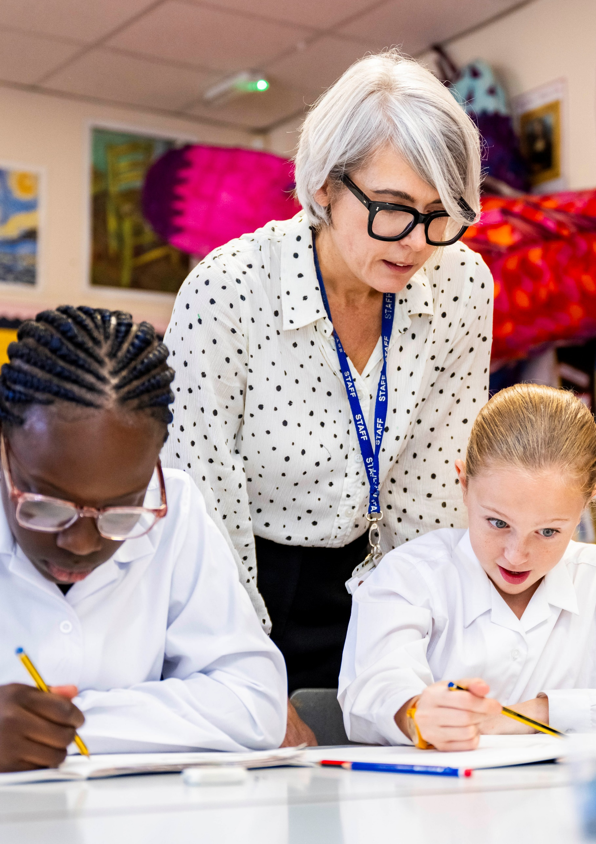
“The School is highly successful in meeting its aim of preparing young people for their role as responsible citizens of the wider world.”
Independent School Inspections – ISI

Slide 9
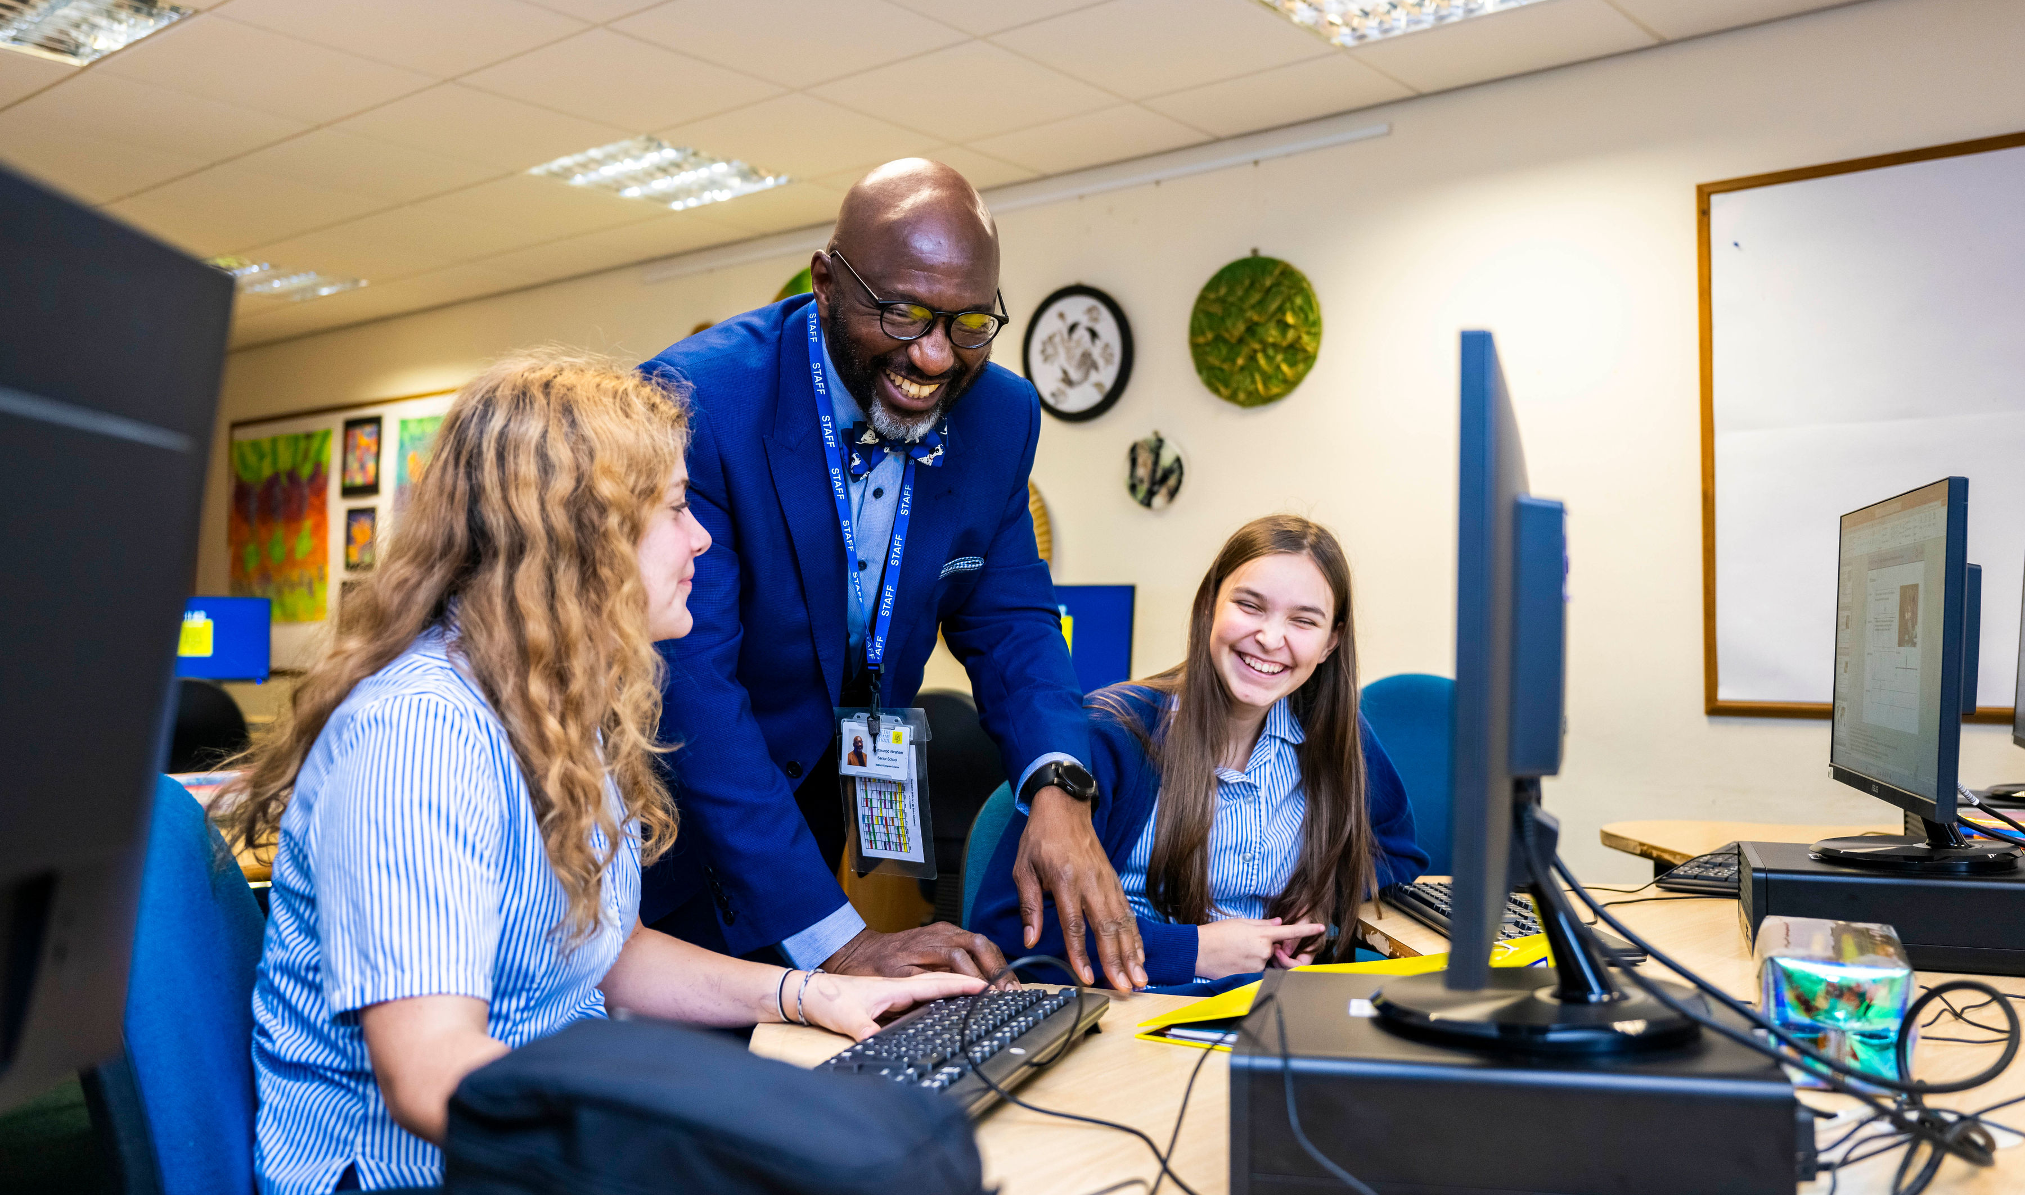
Benefits of Service
  Hours of work
    Permanent
    Part Time – 30 Hours per week
    Set Times of
    08:30-16:30
    Term Time plus 3 weeks.
  Remuneration
    NDSP26
    £31,227.54 FTE
    Actual
    £20,893.63
  Benefits
    The School has high expectations of its staff and therefore looks to reward them with a competitive salary scale and beneficial conditions of service.
      There is an extensive induction programme for all new colleagues, and ongoing professional development is encouraged
      Staff development programme
      Staff wellbeing programme, including 2 paid well-being sessions each year
      Financial contribution to eye tests and glasses for eligible staff
      Employee Assistance programme – counselling, financial advice etc.
      Staff discount on School fees after six months continuous service
      Free lunch during term time
      Free coffee/tea during term time
      Free use of the School’s leisure and sporting facilities, including a heated indoor pool
      Employee Referral Bonus Schemes
      Electric Car Charging
      Free parking

Slide 10
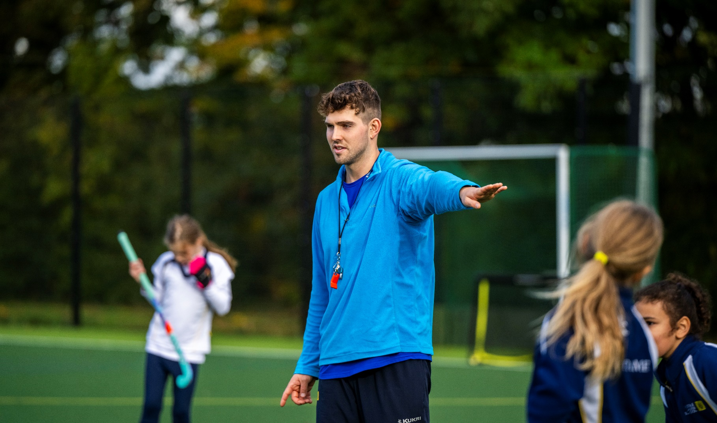
Selection Process
Apply Now:
  Please complete the online application process available
  on our career on our website.
  Work With Us | Notre Dame School
  Closing Date
  As successful candidates are sourced and apply.
  We reserve the right to interview, as suitable candidates are sourced
  Start Date
    ASAP
    Shortlisted candidates will be interviewed by a recruitment panel including members of the Senior Leadership Team and members of HR. Candidates will be required to undertake a task related to the role applied for and be given a tour of the school. Please note that before making an application for any vacancy listed, you should familiarise yourself with our Recruitment Privacy Notice, Safeguarding Policy, Safer Recruitment Policy, Keeping Children Safe in Education and Equal Opportunities Policy which are available at:
    Policies & Reports | Notre Dame School
    Notre Dame School is committed to safeguarding and promoting the welfare of children and young people and expects all staff and volunteers to share this commitment. Applicants must be willing to undergo child protection screening appropriate to the post, including checks with past employers, online checks prior to appointment and the Disclosure and Barring Service.
    The School is an equal opportunities employer and is fully committed to a policy of treating all employees and job applicants equally and does not discriminate on the grounds of race, physical or mental disability, national origin, colour, family status, gender, religion, sexual orientation, age or any other characteristic protected by law.
    For any queries, please contact HR at
    recruitment@ notredame.co.uk or call 01932 589480.

